Slide 1
Audubon Golf Course Database
http://audubonamherst.com/wp-content/uploads/2015/07/audubon_logo_web31.png
Christian Tjahjadi-Lopez, Matthew Maggio, Jenna Prentiss, Andrew Cole-Goins, Liying Yang

Slide 2
Organization Background
Primarily based on customer loyalty
Golf Courses rely on “regulars” for a large portion of their business
Course lacks database, currently receipt-based
Management struggles with accounting due to misinformation, human error, and loss of receipts

Slide 3
Proposition
Our database system was created to:
Record current and new customer base
Reward loyalty customers based on totals spent
Keep record of employees
Simplify the current paper-based information system
List product and services and the rewards affiliated with each

Slide 4
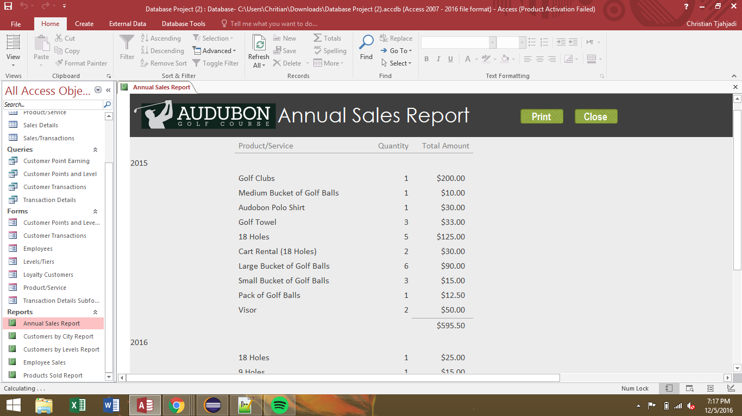
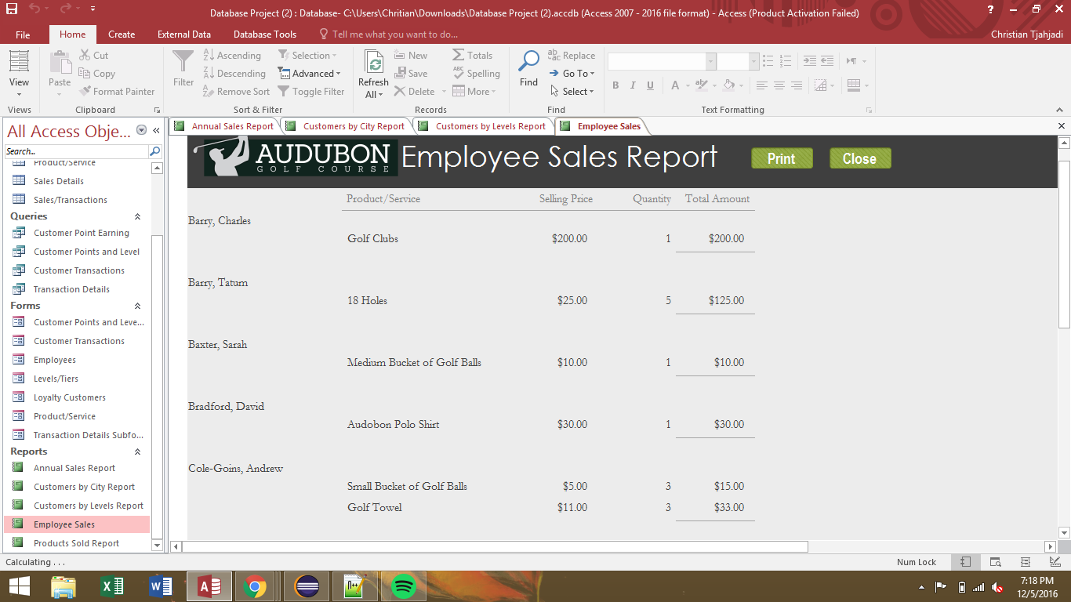
Reports

Slide 5
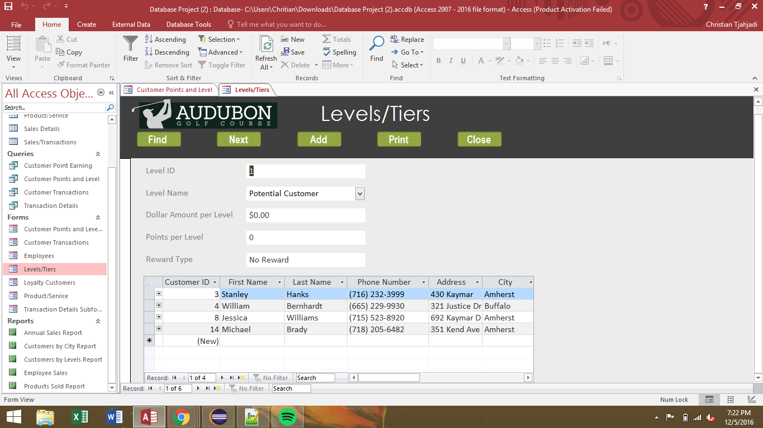
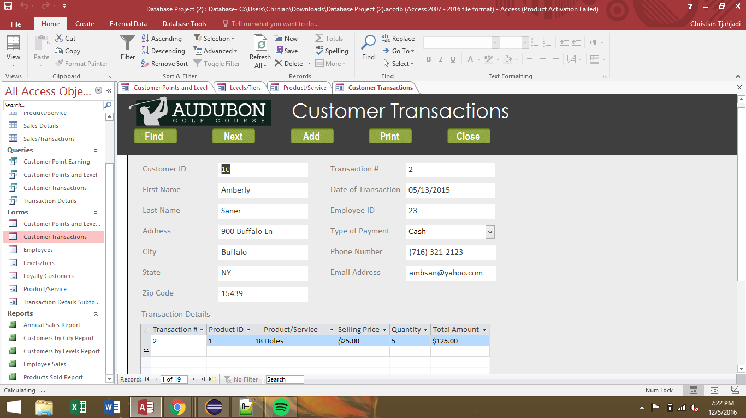
Forms

Slide 6
Implemented Changes
Added a rewards system for returning customers
Removed the paper based accounting system
Streamlined customer lookup for members
Helped reduce wait time for check-in

